Slide 1





how to use
[your steam mop]
in 3 steps
Everything blue is a guide. Delete it before you download.
Notes:
Slide 1. Hook. Swap in a photo of your product. Edit [your steam mop].

Slide 2

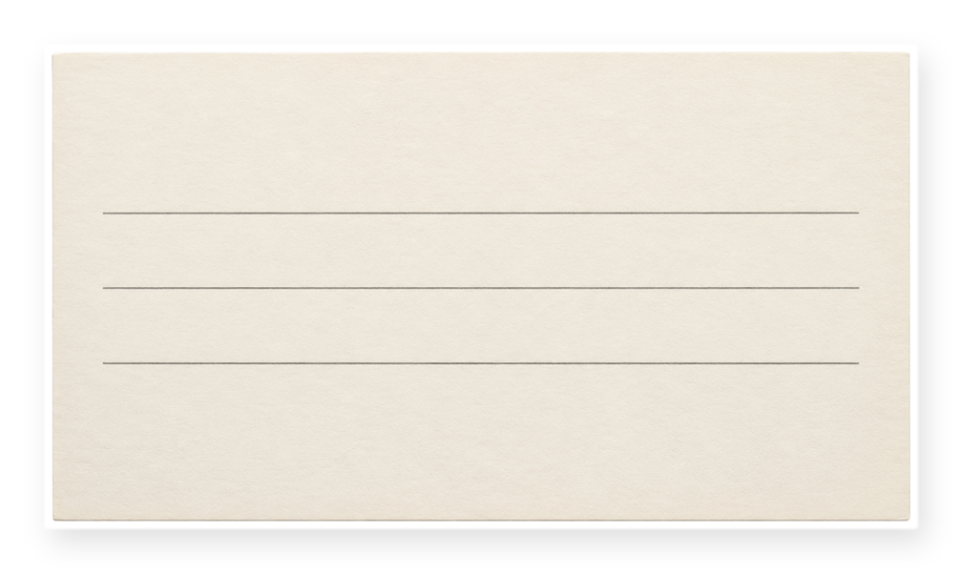



[just got one?]
[here is how to
use it]
[3 steps, that is all]
Notes:
Slide 2. Second hook: Instagram often shows a carousel starting on slide 2, so this one works as a cover on its own. No photo needed. Edit both [bracket] lines.

Slide 3
1. [rinse the pad]
Notes:
Slide 3. Step 1: swap in its photo and name it.

Slide 4



2. [unwind + plug in]
Notes:
Slide 4. Step 2: a close-up. Move the circle onto the click.

Slide 5



3. [glide]
Notes:
Slide 5. Step 3: swap in its photo. Name it.

Slide 6

the result
done in
[2 minutes]
Notes:
Slide 6. The result: a full-page photo. Edit the note.

Slide 7


1. [rinse the pad]
2. [unwind + plug in]
3. [glide]
that's it.
Notes:
Slide 7. Recap: the three step photos sit on the cubes. Edit the steps on the card.

Slide 8


Comment
"[KEYWORD]"
[Product name]
Notes:
Slide 8. Swap in a photo of your product. Type its name and your keyword. Caption to start from (CTA in the first two sentences, 3 hashtags): Comment [KEYWORD] and I will send you [the link]. [One line of real context: who it helps or how you use it.] #[tag] #[tag] #[tag]

